Slide 1
2025 – MVT Signal Acquisition with FPGA
Sadie, Adriaan

Slide 2

Technology Project - 2025 Multi-voltage thresholding (mVT) Signal acquisition with FPGA
Background on MVT
Objectives of Research
Hardware Setup
Calibration
ADC Acquisition firmware
Metastable Sample Region
Results
Conclusion and Recommendations
Project Resources
References

Slide 3
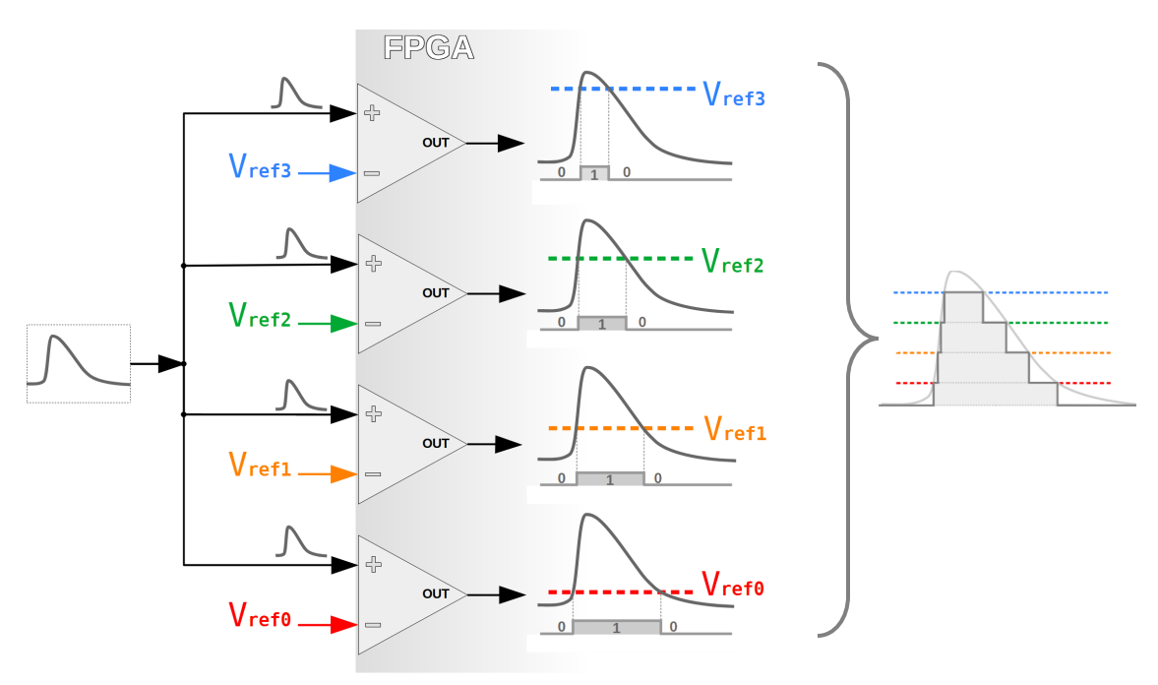
Technology Project: MVT with FPGA background on MVT
Multi-Voltage Thresholding (MVT) Overview Samples an analogue signal similarly to flash-based ADCs Uses a voltage ladder to divide the signal into discrete digital levels Traditionally implemented with a resistor ladder on an IC Proposed FPGA-Based Approach LVDS ports of the FPGA are repurposed as comparators An external DAC generates the reference voltages Enables very high sampling rates — up to 1 GSPS with proper configuration

Slide 4

Technology Project: MVT with FPGA background on MVT
Advantages Potential for extremely high-speed sampling Minimal external circuitry required Limitations Exponential growth in resource and pin requirements with resolution Requires 2ⁿ – 1 comparators and 2(2ⁿ – 1) FPGA pins Impractical for high-resolution designs (e.g., 12-bit → 4095 comparators, 8190 pins) Use Case Suited for niche, ultra-high-speed, low-resolution applications

Slide 5
Technology Project: MVT with FPGA Objectives of research
Research Goal Assess feasibility of implementing Multi-Voltage Thresholding (MVT) on a Zynq UltraScale+ MPSoC Demonstrate its potential as a replacement for conventional ADCs in specific applications Objectives PCB Design & Fabrication Integrate DAC circuitry for seamless connection to the MPSoC evaluation kit DAC Calibration Perform calibration using the method described in [1] Digital Encoding IP Core Adapt or develop an IP core to convert LVDS comparator outputs into a 4-bit digital code System Testing Apply known analogue inputs and verify accurate digital reconstruction of signals

Slide 6
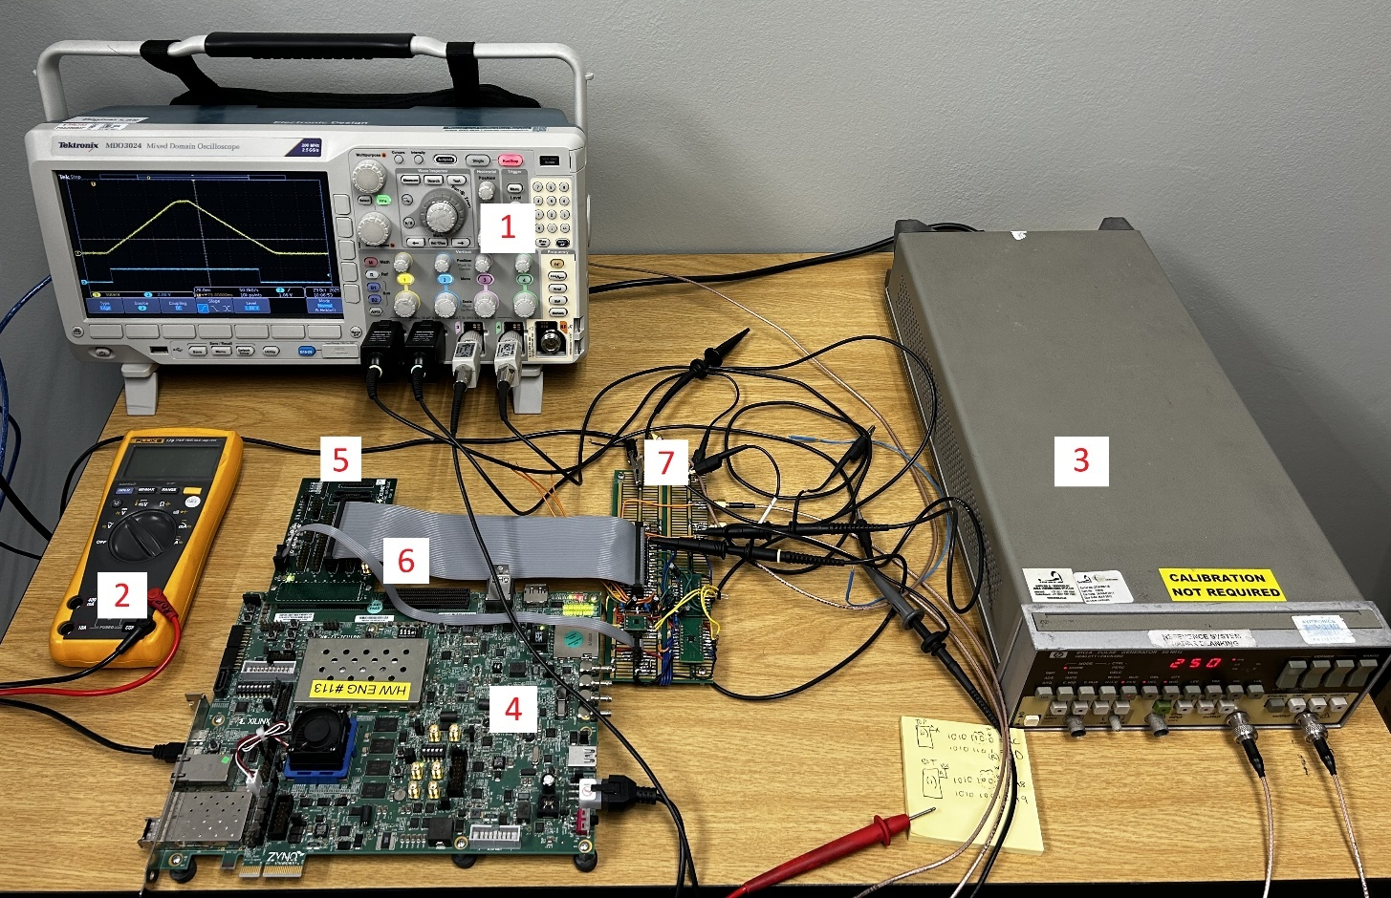
Technology Project: MVT with FPGA Hardware setup

Slide 7

Technology Project: MVT with FPGA Hardware setup
Prototyping Approach Prototyping PCB used instead of a custom design Focus was on proof of principle, not performance limits Reduced time and cost Hand-soldered PCB sufficient for project goals Test Setup Overview XM105 Debug Card (Xilinx) - Expands HP I/O pins of the MPSoC Evaluation Kit 8112A Pulse Generator – used for DAC calibration Fluke 179 Multimeter – for general measurements and verifying DAC outputs Tektronix MDO3024 Oscilloscope – used for debugging and as a signal source (AFG output)

Slide 8
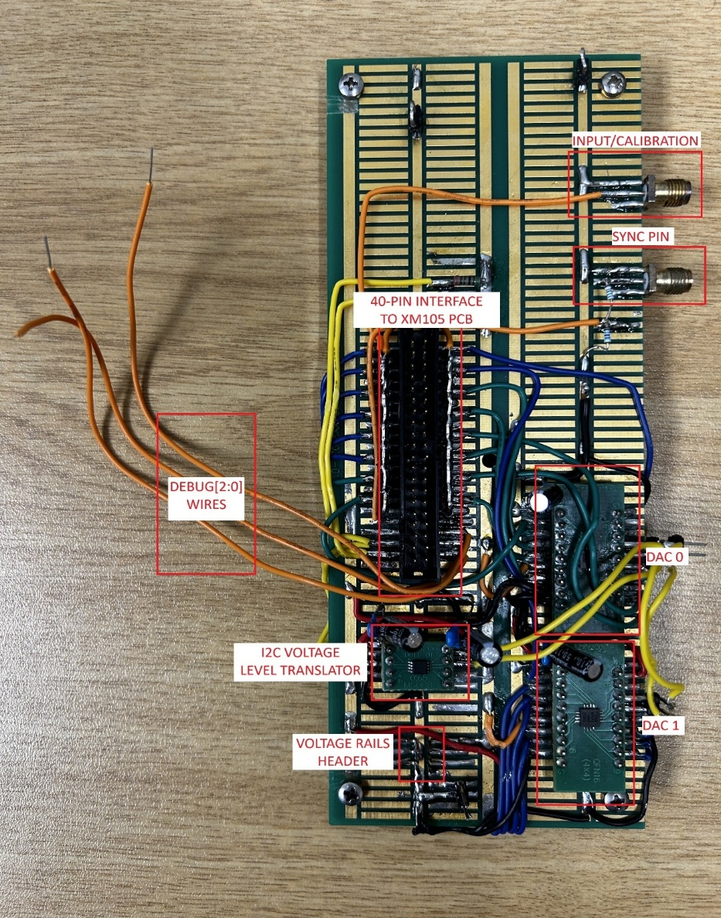
Technology Project: MVT with FPGA Hardware setup
Prototype PCB Overview Implements a 4-bit MVT-based ADC Uses multiple voltage thresholds and LVDS inputs Hardware Components Dual DAC setup generates reference voltages Level translator ensures logic compatibility I²C communication between DACs and MPSoC Connections & Interfaces Linked to XM105 debug card for I/O and power Includes debug lines for firmware testing SMA connectors for signal input and synchronization

Slide 9
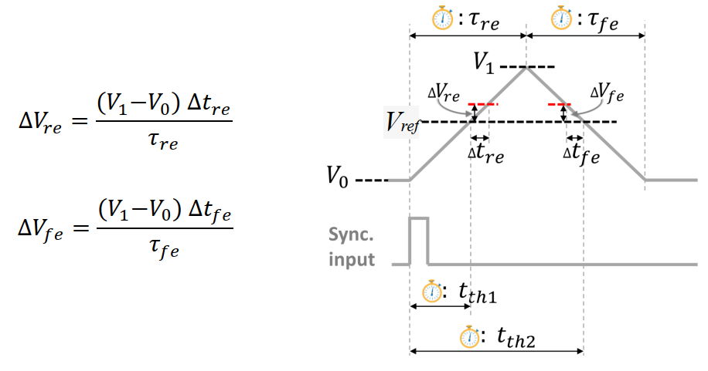
Technology Project: MVT with FPGA calibration
Sync-Pulse + Triangle Calibration Requires a dual-output signal generator Pulse train: triggers synchronization in firmware Triangular waveform: applied to LVDS comparator input DAC reference voltage applied to the comparator’s opposite input Firmware records timer values at LVDS output transitions Transition timestamps used to calculate comparator bias voltage

Slide 10

Technology Project: MVT with FPGA calibration
Bias Voltage Measurement Process Reference voltage set and comparator triggered on rising edge Firmware counter records timestamps synchronized to pulse input Data stored in BRAM, then processed via Python script for bias voltage calculation Calibration Setup Pulse generator provides sync pulse and slow-ramping waveform Calibration applied across all DAC channels (three comparators shown: bit 0, bit 4, bit 10) Threshold-crossing time determined from waveform timing (e.g., 43.6 ms for 1 V level) Deviation from theoretical count indicates comparator bias magnitude and polarity

Slide 11
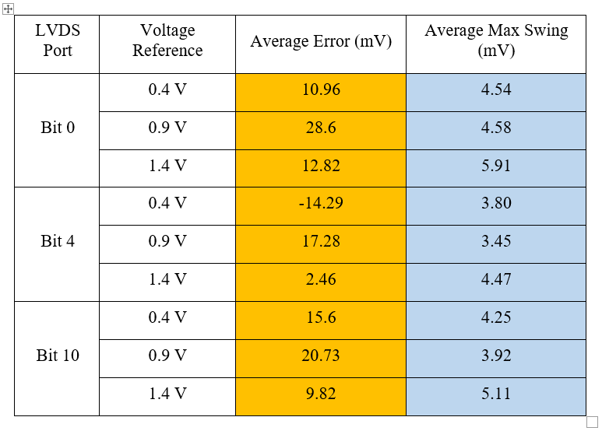
Technology Project: MVT with FPGA calibration
Results:

Slide 12
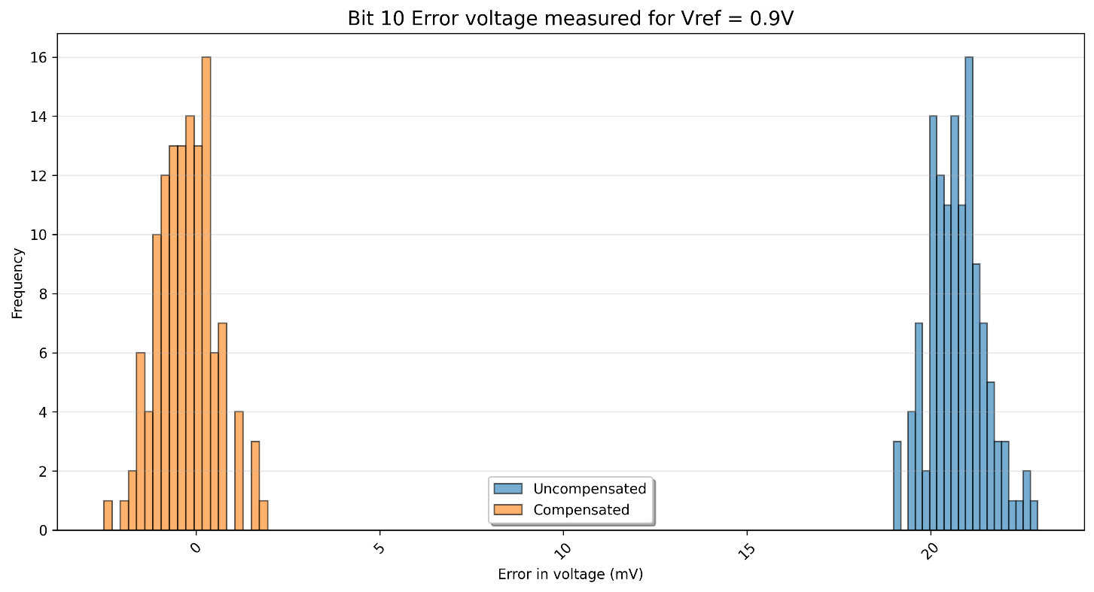
Technology Project: MVT with FPGA calibration
After Compensation:

Slide 13
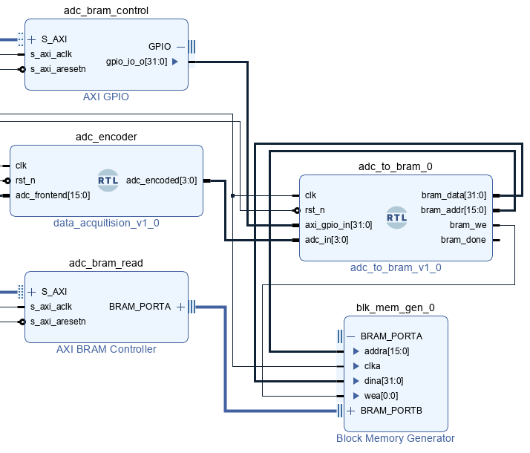
Technology Project: MVT with FPGA adc acquisition firmware
Firmware Development Original plan: extend open-source “MVT-quad” core (2-bit ADC using 4 comparators) Final approach: develop new firmware modeled after a Flash-ADC architecture Firmware Blocks adc_encoder: Encodes 16 comparator inputs into a 4-bit digital value adc_to_bram_0: Stores ADC outputs in BRAM each clock cycle adc_bram_control: Triggers data capture via control signal

Slide 14
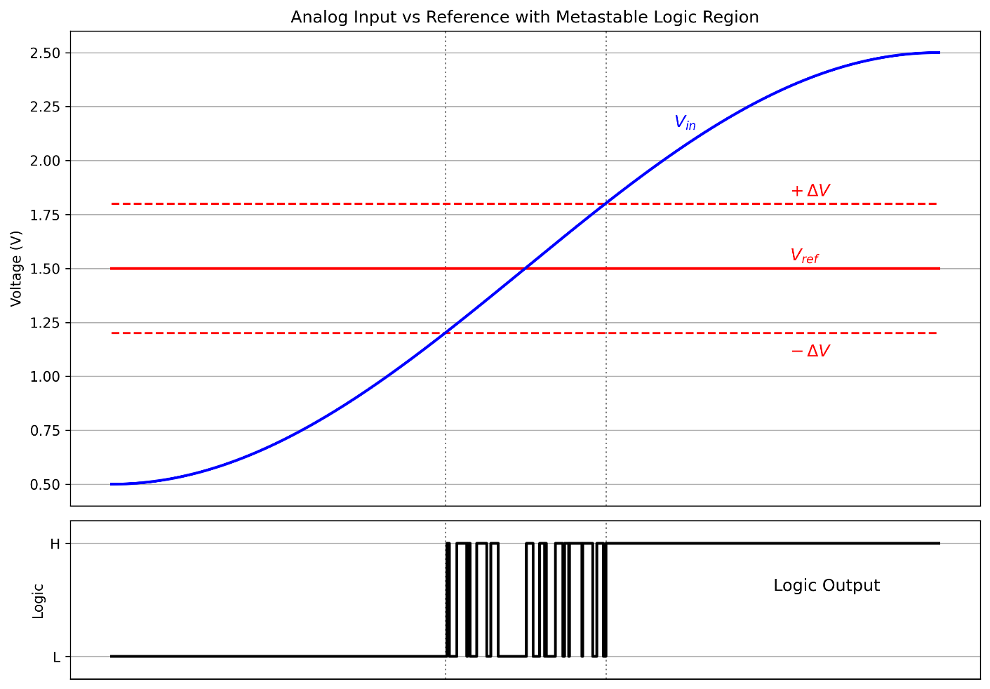
Technology Project: MVT with FPGA metastable sample region
Metastability Effects Each comparator has a small metastable region near its reference voltage Sampling during this window can cause incorrect output data Only one comparator affected at a time Error rate increases with higher sampling frequencies

Slide 15

Technology Project: MVT with FPGA results
Signal Acquisition Test 500 kHz sine wave (850 mV amplitude, 850 mV offset) generated within 1.8 V range ADC output captured in BRAM and compared with input waveform Sampling rate: 200 MHz (firmware system clock) Initial glitch observed ≈0.25 V → caused by metastable sampling error

Slide 16
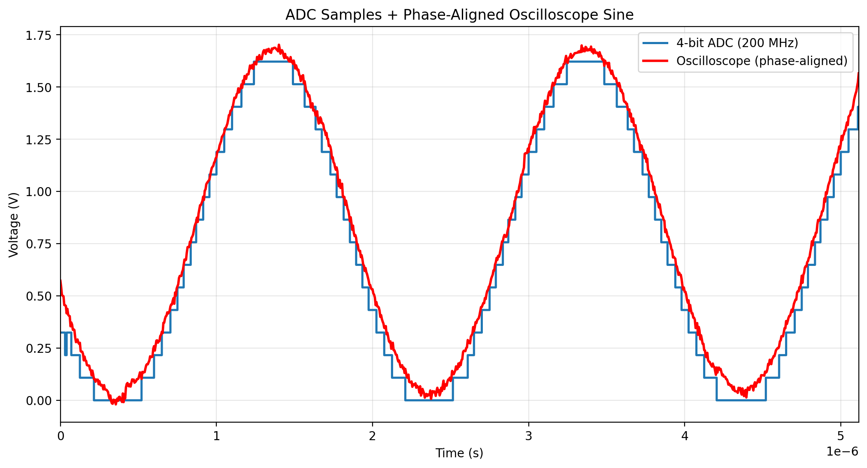
Technology Project: MVT with FPGA results

Slide 17
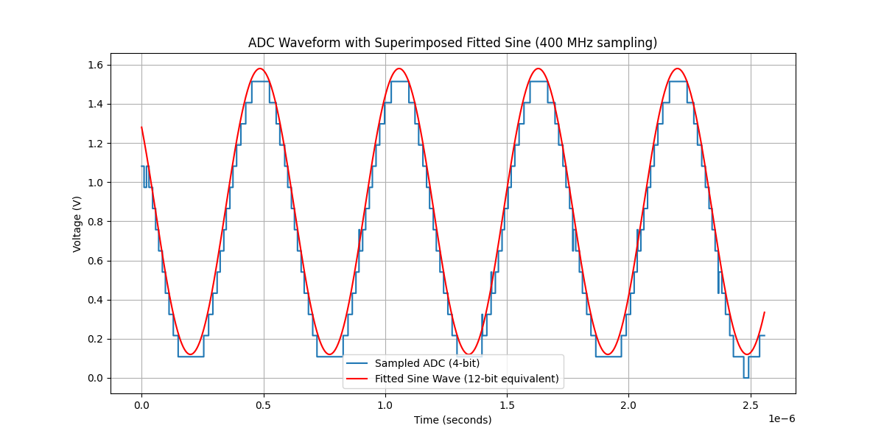
Technology Project: MVT with FPGA results

Slide 18
Technology Project: MVT with FPGA conclusion and recommendations
Conclusion 4-bit MVT ADC successfully implemented on Zynq UltraScale+ MPSoC using LVDS ports as comparators and external DACs for reference voltages Prototyping PCB integrated with ZCU106 + XM105 for full hardware interfacing Custom firmware developed for DAC control, bias calibration, and high-speed acquisition Key Results Comparator offsets up to 30 mV; reduced to <1 mV after calibration Accurate signal reconstruction at 200 MHz–400 MHz sampling rates Glitches linked to metastable regions, increasing with frequency

Slide 19

Technology Project: MVT with FPGA conclusion and recommendations
Significance Demonstrates MVT as a fast, low-resource ADC alternative Exploits FPGA I/O flexibility—no dedicated ADC hardware needed Ideal for high-speed, low-resolution, or resource-limited applications Outcome Establishes MVT as a practical and scalable technique for FPGA-based signal digitization in niche applications

Slide 20

Technology Project: MVT with FPGA conclusion and recommendations
Recommendations for Future Research Improve Firmware IP Cores Fix I²C read functionality for the AD5669 DAC Replace with a generic AXI-based I²C controller supporting full read/write access Automate Calibration Current calibration is manual and multi-step Implement automatic firmware calibration to: Apply reference voltages Measure thresholds Compute and update bias values

Slide 21
Technology Project: MVT with FPGA conclusion and recommendations
Recommendations for Future Research Develop Successive Approximation ADC Use existing DAC setup to enable high-accuracy SAR conversion Target ±2 mV accuracy via firmware-controlled operation Test Higher Sampling Frequencies Introduce dual-phase clocking for faster sampling Explore rates up to 1.4 GHz, considering metastability challenges

Slide 22
Technology Project: MVT with FPGA conclusion and recommendations
Recommendations for Future Research Improve Sampling Robustness Implement double- or multi-flop synchronization Reduce metastability propagation during high-speed sampling Explore Metastability-Based Calibration Investigate statistical calibration method Compare bias stability with sync-pulse-plus-triangle approach Develop firmware to automate transition counting and bias mapping

Slide 23

Technology Project: MVT with FPGA project resources
All files available on GitHub and Bitbucket repos: https://github.com/AdriaanSadie/MVT_ADC_TECH https://bitbucket.cn.za.saabgroup.com/scm/hrden/mvt-adc-technology-project.git

Slide 24

Technology Plan: MVT with FPGA References
Eliseev, D., et al. "An open-sorce IP-Core for Multi-Voltage Thresholding signal acquisition with FPGAs." Journal of Instrumentation 19.02 (2024): C02035.

Slide 25

http://www.saabgroup.com
Thank You

Slide 26
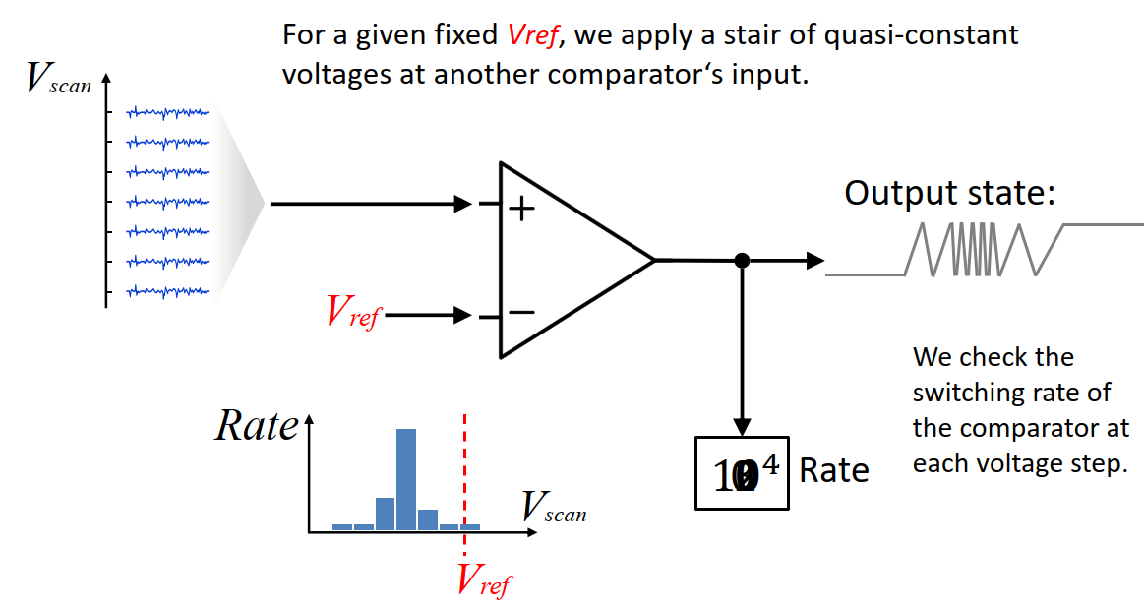
Technology Project: MVT with FPGA Calibration
Method 2: Metastability-Based Calibration No external signal generator required Uses statistical behaviour of comparator metastability DAC reference applied to inverting input; quasi-static DAC voltage to non-inverting input FPGA measures comparator switching rate for each voltage step Peak switching rate identifies metastability point → bias voltage

